Slide 1
Surfactant
Duncan

Slide 2
Introduction
The lungs of preterm infants lack adequate pulmonary surfactant, a constituent of the air- liquid interface, that normally lines the alveolar surfaces and terminal airways.
RDS is due to surfactant deficiency, which increases the surface tension at the air-liquid interface of the terminal respiratory units. This leads to atelectasis and increases ventilation perfusion mismatch.

Slide 3
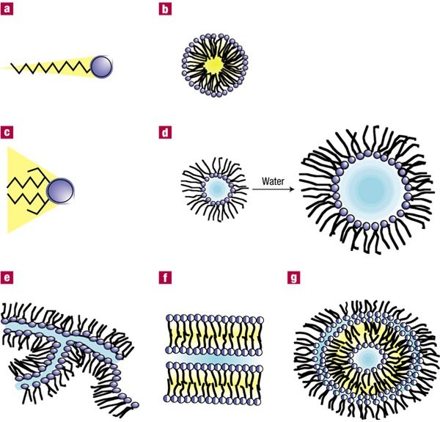

Slide 4
Composition of Surfactant
Composition — Pulmonary surfactant is a complex mixture of lipids and proteins that lowers alveolar surface tension.
Lipid — Approximately 70 percent of the lipid in surfactant is phosphatidylcholine species. Of this, approximately 60 percent is disaturated palmitoylphosphatidyl choline (DPPC)
Protein — Surfactant also contains small proteins. These consist of the hydrophobic surfactant proteins SP-B and SP-C and the hydrophilic proteins SP-A and SP-D

Slide 5
Composition of Surfactant
SP-B is required for normal pulmonary function.
Infants with a mutation in the SFTPB gene resulting in deficient or abnormal SP-B expression have severe respiratory failure that is lethal in the perinatal period.
The intracellular functions of the protein were elucidated in a knockout mouse model with deletion of the gene encoding SP-B; respiratory failure developed immediately after birth. In this mouse, type II cells lack typical lamellar bodies, have abnormal accumulation of lipid vesicles, and cannot process SP-C precursor protein, indicating the role of SP-B in the reprocessing, storage, and secretion of surfactant in type II respiratory epithelial cells

Slide 6
SP-C promotes the formation of the phospholipid film lining the alveolus. The extent of its role in surfactant function is uncertain.
Humans with SP-C deficiency do not have respiratory distress at birth, but develop interstitial pulmonary fibrosis in early childhood.
The knockout mouse counterpart of this human disorder develops a progressive pulmonary disorder with histological features consistent with interstitial pneumonitis.

Slide 7
SP-A and SP-D are small hydrophilic proteins that are members of the collectin protein family.
The primary role of these proteins is in host defense of the lung. SP-A and SP-D facilitate the uptake and killing of bacterial and viral pathogens by immune cells, and appear to have a direct antimicrobial role.
There are no studies in humans that support a role for these proteins in infants with RDS, but there are animal studies suggesting an association with a deficiency of these proteins and a predilection for lung inflammation and infection.

Slide 8
Surface tension
Normal lung function requires patent alveoli that are closely situated to appropriately perfused capillaries.
Molecular forces of the water molecules in the alveolar lining result in high surface tension and a tendency of the air spaces to collapse, especially at low volumes.
The hydrophilic and hydrophobic properties of DPPC result in a head-to-tail orientation in the air-liquid interface inside the alveolus.
When the alveolar volume decreases during exhalation and the fluid in the air-liquid interface is compressed, these surface-active molecules in the interface are squeezed together, excluding water molecules.

Slide 9
As a result, pulmonary surfactant reduces the surface tension of the liquid lining, decreasing the pressure needed to keep the alveoli inflated and maintaining alveolar stability.
According to LaPlace's law, the pressure (P) necessary to keep the sphere open is proportional to the surface tension (T) and inversely proportional to the radius (R) of the sphere, shown by the formula
P = 2T/R
If the surface tension is high and the alveolar volume is small (ie, the radius is low), as occurs at end expiration, the pressure necessary to maintain the alveolus open is high.

Slide 10


Slide 11
Types of Surfactant
Natural Surfactant
Three natural surfactants are commercially available: poractant alfa, calfactant, and beractant
obtained by either animal lung lavage or by mincing lung tissue (eg, lung minces)
subsequently purified by lipid extraction, removing hydrophilic components that include the hydrophilic surfactant proteins A and D.
the purified lipid components retain surfactant proteins B and C, neutral lipids, and surface active phospholipids (PL) such as dipalmitoylphosphotidylcholine (DPPC).
DPPC is the primary surface active component that improves alveolar surface tension.

Slide 12
Commercial Natural Surfactant Types and Composition
Surfactant | Origin | Surfactant protein B content | Conc of phospholipid | Initial dose | Repeat dosing schedule
Poractant alfa | Porcine lung minces, lipid extraction with purification using liquid-gel chromatography | 0.38% of PL | 80 mg PL per ml | 2.5 ml/kg (200 mg/kg PL) | 1.25 ml/kg (100 mg/kg PL) every 12 h as needed up to 2 total doses
Calfactant | Calf lung lavage, lipid extraction | 0.74% of PL | 35 mg PL/ml | 3.0 ml/kg (105 mg/kg PL) | 3.0 ml/kg (105 mg/kg PL) every 12 h as needed up to 3 total doses
Beractant | Bovine lung minces, lipid extraction. Supplemented with DPPC, palmitic acid and tripalmitin | 0.044% of PL | 25 mg PL/ml | 4.0 ml/kg (100 mg/kg PL) | Repeat same dose every 6 h as needed for total of 4 doses

Slide 13
Synthetic Surfactant
currently no synthetic surfactant products available for clinical use.
the one synthetic product, Colfosceril palmitate, that was available contained DPPC, cetyl alcohol, and tyloxapol
Withdrawn from market

Slide 14
So… Which is better?
Compared with older synthetic preparations without protein B and C analogues, natural surfactants have been shown to be superior in clinical trials.
In particular, natural preparations permitted relatively lower inspired oxygen concentration and ventilator pressures
this in part resulted in a decrease in mortality rates and complications of RDS in preterm infants

Slide 15
In that case, why are we persisting in research for synthetic surfactant?
Decreased immunogenicity
Decreased potential to transmit animal-borne infectious agents
Large quantities of material that is consistent in composition

Slide 16


Slide 17
Natural vs Synthetic without protein analogues
Natural surfactant extract versus synthetic surfactant for neonatal respiratory distress syndrome. AUSoll RF; Blanco F SOCochrane Database Syst Rev 2001;(2):CD000144.
■
The relative superiority of natural surfactant compared to older synthetic surfactants (without protein B and C
analogues), particularly in terms of a decrease in mortality rate and risk of developing pneumothorax, was best illustrated by a meta-analysis of 11 randomized controlled studies of 4658 preterm infants (from 1975 to 2000). The following results were reported:
In 10 studies, patients treated with natural surfactant had a lower mortality rate than those treated with synthetic surfactant (15.8 versus 18.4 percent; RR 0.86, 95% CI
0.76-0.98).
In nine studies, there was a lower incidence of pneumothoraces in patients treated with natural surfactant than in patients treated with synthetic surfactant (6.9 versus 10.9 percent; RR 0.63, 95% CI 0.53-0.75).

Slide 18
In seven studies, there was a higher incidence of intraventricular hemorrhage (IVH) in the patients treated with natural surfactant than in patients treated with a synthetic preparation (34.2 versus 31.5 percent; RR 1.09, 95% CI 1.00-1.19). However, there was no difference in risk for severe IVH (defined as grades 3 and 4) between the two groups.
There was no difference between groups in the incidence of patent ductus arteriosus, sepsis, retinopathy of prematurity, bronchopulmonary dysplasia (BPD), or chronic lung disease (CLD); CLD was defined as an oxygen requirement at 36 weeks adjusted age.

Slide 19
Natural vs Synthetic with protein
analogues
One synthetic product, named lucinactant, contains a 21 amino acid peptide called KL
positively charged lysine molecules (K) are separated by 4 leucine molecules (L).
KL4 appears to mimic surfactant protein B and combines with phospholipids.
The relative efficacy of this agent compared to other synthetic surfactants and natural surfactants was evaluated in two well-designed studies

Slide 20
(1) 1294 preterm infants (gestational age less than 32 weeks) were assigned to
receive colfosceril palmitate, a synthetic surfactant without surfactant proteins, (509 patients)
lucinactant (527 patients)
or beractant, a natural surfactant(258 patients)
All forms of surfactant were administered within 20 to 30 minutes after birth.
Compared with colfosceril palmitate, lucinactant significantly reduced the incidence of RDS at 24 hours of life (39 versus 47 percent) and BPD at 28 days (40 versus 45 percent). No difference between lucinactant and beractant in these outcomes.
In addition, mortality due to RDS at 14 days was significantly lower with lucinactant versus both colfosceril palmitate (5 versus 9 percent) and beractant (5 versus 10 percent).
A multicenter, randomized, masked, comparison trial of lucinactant, colfosceril palmitate, and beractant for the prevention of respiratory distress syndrome among very preterm infants. AUMoya FR; Gadzinowski J; Bancalari E; Salinas V; Kopelman B; Bancalari A; Kornacka MK; Merritt TA; Segal R; Schaber CJ; Tsai H; Massaro J; d'Agostino R SOPediatrics 2005 Apr;115(4):1018-29

Slide 21
(2) 252 preterm infants (gestational age less than 28
weeks), were randomly assigned
■
■
either lucinactant
or poractant alfa, a natural surfactant
■
within 30 minutes after birth
No significant differences in survival without BPD at 28 days of life and at 36 weeks postmenstrual dates.
In addition, no significant differences were observed in the incidence of grade 3 or 4 IVH, NEC, PDA, pneumothorax, or retinopathy of prematurity.
A major limitation of this study was enrollment reached only one-half the sample size that was originally
■
■
calculated.
A multicenter, randomized, controlled trial of lucinactant versus poractant alfa among very premature infants at high risk for respiratory distress syndrome. Sinha SK; Lacaze-Masmonteil T; Valls i Soler A; Wiswell TE; Gadzinowski J; Hajdu J; Bernstein G; Sanchez-Luna M; Segal R; Schaber CJ; Massaro J; d'Agostino R. Pediatrics 2005 Apr;115(4):1030-8.

Slide 22
A meta-analysis of the two trials demonstrated
no differences between infants treated with synthetic surfactant versus those who received animal derived surfactant at 36 weeks adjusted gestational age in the
rates of mortality (RR 0.81, 95% CI 0.64-1.03)
chronic lung disease (RR 0.99, 95% CI 0.84-1.18)
or the combined outcome of death and chronic lung disease (RR 0.96, 95% CI 0.82-1.12)
Protein containing synthetic surfactant versus animal derived surfactant extract for the prevention and treatment of respiratory distress syndrome. AUPfister R; Soll R; Wiswell T SOCochrane Database Syst Rev. 2007 Oct 17;(4):CD006069
In a subsequent report, participants from both of the two trials were evaluated at one year corrected age
There was no difference in survival rate between the patients treated with lucinactant and those treated with natural surfactant (74 versus 71 percent, OR 0.83; 95% CI 0.61-1.12).
The incidences of posthospital readmissions and respiratory illnesses, and neurologic outcome did not

Slide 23


Slide 24
Timing of surfactant
administration
■
Surfactant is administered in preterm infants using three
different timing strategies.
Prophylactic surfactant therapy, which is administered at the time of delivery to infants at risk of RDS.
Early therapy, which is administered by two hours of age frequently before the diagnosis of RDS
Rescue surfactant therapy, which is given once the diagnosis of RDS is established.
In all three strategies, surfactant therapy improves mortality and morbidity in preterm infants when compared to untreated patients
However, clinical trials suggest that prophylactic or early therapy is superior to rescue therapy alone in infants at high-risk for RDS (below 30 weeks gestation)
■
■
Surfactant-replacement therapy for respiratory distress in the preterm and term neonate. Engle WA Pediatrics. 2008 Feb;121(2):419-32

Slide 25
Prophylactic or early versus
rescue therapy alone
■
The decision to administer prophylactic or early
surfactant therapy versus rescue therapy is based upon
the identification of the infant at risk for RDS who may benefit from preventive therapy.
The principal risk factor is gestational age, with infants less than 30 weeks gestational age being at the highest
■
risk for the development of RDS, as well as having the highest risk of mortality and morbidity associated with RDS.
In at-risk infants, prophylactic or early treatment is associated with a decrease in morbidity and mortality compared to rescue treatment for established RDS. This was best illustrated in two separate meta-analyses.
■

Slide 26
The first meta-analysis compared early to rescue therapy in four randomized controlled studies with 3459 patients. Early treated patients received surfactant preparation within the first two hours of life, while rescue treated patients received surfactant after the diagnosis of RDS was established. Two of the studies used natural surfactant and the other two synthetic
preparations.
Early versus delayed selective surfactant treatment for neonatal respiratory distress syndrome. Yost CC; Soll RF Cochrane Database Syst Rev 2000;(2):CD001456
The following results were reported:
– In all four studies, early treated patients had a significantly reduced mortality rate compared to rescue treated patients (19.5 versus 22.3 percent; RR 0.87, 95% CI 0.77 to 0.99).

Slide 27
There was a significant decrease in complications in early treated patients compared to rescue treated patients including
pneumothorax (11.9 versus 17.1 percent; RR 0.70,
95% CI 0.59 to 0.82)
pulmonary interstitial emphysema (9.6 versus 14.8 percent; RR 0.63, 95% CI 0.59 to 0.82)
chronic lung disease (CLD) (8.7 versus 10.8 percent; RR 0.7, 95% CI 0.55 to 0.88).
There were no differences in the incidences of patent ductus arteriosus, intraventricular hemorrhage (IVH), retinopathy of prematurity, bronchopulmonary dysplasia (BPD), and necrotizing enterocolitis (NEC).

Slide 28
The second meta-analysis compared prophylactic to rescue therapy in eight randomized controlled studies with 2818 patients.
Prophylactic versus selective use of surfactant in preventing morbidity and mortality in preterm infants. Soll RF; Morley CJ Cochrane Database Syst Rev 2001;(2):CD000510
All patients were treated with natural surfactant preparations.
Prophylactic treated infants were intubated in the delivery room and received surfactant therapy prior to the first breath or immediately after intubation or stabilization.
Rescue treated patients received surfactant after the diagnosis of RDS was established. Studies selected infants at high risk for RDS using inclusion criteria of gestational age less than 32 weeks gestation.

Slide 29
In seven studies, prophylactic treated patients had a significantly reduced morality rate compared to rescue
■
treated patients (7.2 versus 11.7 percent; RR 0.61, 95%
CI 0.48 to 0.77).
■
In a secondary analysis of infants less than 30 weeks
gestation, prophylactic therapy decreased mortality compared to rescue therapy (10.3 versus 16.3 percent; RR 0.62, 95% CI 0.49 to 0.78).
There were decreases in prophylactic treated infants compared to those treated with rescue strategy in
pneumothorax (3.3 versus 5.4 percent; RR 0.62, 95%
CI 0.42 to 0.89)
pulmonary interstitial emphysema (12.2 versus 19.8 percent; RR 0.54, 95% CI 0.36 to 0.82).
There were no differences in the incidences of patent ductus arteriosus, IVH, retinopathy of prematurity, BPD, and NEC between groups.
■
■

Slide 30
These data indicate that for every 100 babies at high risk for RDS, prophylactic surfactant versus rescue therapy alone would result in five fewer deaths.

Slide 31


Slide 32
Prophylactic versus early therapy
■
Although there are no clinical trials that compare prophylactic to
early therapy, there is some indirect evidence to suggest that prophylactic therapy is superior to later preventive (early) therapy
■
Even short delays of administration of surfactant may worsen
outcomes.
In a randomized study of early versus delayed surfactant in 2690 infants at high risk for RDS, for example, the combined outcome of death and BPD was reduced by 11 percent in patients who received surfactant before two hours of life compared to those treated at three hours of life.
Early versus delayed neonatal administration of a synthetic surfactant--the judgment of OSIRIS. The OSIRIS Collaborative Group (open study of infants at high risk of or with respiratory insufficiency--the role of surfactant. Lancet 1992 Dec 5;340(8832):1363-9
Although this study suggests earlier administration of surfactant is beneficial, it did not directly compare prophylactic administration in the delivery room to administration in the neonatal intensive care setting.
Early versus delayed neonatal administration of a synthetic surfactant--the judgment of OSIRIS. The OSIRIS Collaborative Group (open
study of infants at high risk of or with respiratory insufficiency--the role of surfactant. AUSOLancet 1992 Dec 5;340(8832):1363-9
There is evidence suggesting that spontaneous breathing or mechanical ventilation in infants with surfactant deficiency injures the lung within the first hour of life.
– This was demonstrated in an autopsy study of infants who died before 12 hours of life. Nine infants who lived from one to ten hours had evidence of hyaline membrane disease by histology.
■

Slide 33
How to administer surfactant
■
For all of the surfactant replacement therapy trials,
surfactant was instilled in liquid form via the endotracheal tube.
Some trials instilled all of the surfactant at once, while others instilled it in smaller aliquots. Only one very small trial compared a slow infusion with bolus administration of surfactant.
It concluded that slow infusion was at least as effective as bolus therapy.
There is no evidence to support the practice of placing the infant in multiple different positions during the
■
■
administration of surfactant
Hatchel R, Brune T, Franke N, Harms E, Jorch G. Sequential changes in compliance and resistance after bolus administration or slow infusion of surfactant in preterm infants. Intensive Care Med 2002;28:622-8.

Slide 34
Should multiple or single doses of surfactant be
used?
■
Two trials of multiple versus single doses of surfactant replacement therapy (which included 394 babies in total)
have been reviewed.
■
These studies compared infants treated with
a single dose with [Soll RF. Multiple versus single dose natural surfactant extract for severe neonatal respiratory distress syndrome (Cochrane Review). In: The Cochrane Library, Issue 4, 2004. Chichester, UK: John Wiley & Sons, Ltd. ]
either retreatment with up to three doses within the first 72 h for infants who had a deterioration (shown by a 0.1 increase in the fraction of inspired oxygen [FiO2] after an initial response) [Dunn MS, Shennan AT, Possmayer F. Single- versus multiple-dose surfactant replacement therapy in neonates of 30 to 36 weeks’ gestation with respiratory distress syndrome. Pediatrics 1990;86:564-71.]
or retreatment with up to three doses at 12 h and 24 h after the initial dose for infants who remained intubated and required oxygen . [Speer CP, Robertson B, Curstedt T, et al. Randomized European multicenter trial of surfactant replacement therapy for severe neonatal respiratory distress syndrome: Single versus multiple doses of Curosurf. Pediatrics 1992;89:13-20.]

Slide 35
– It should be noted that the babies studied were a
heterogeneous group with gestational ages that ranged from 30 to 36 weeks in one study and a birthweight range of 700 g to 2000 g in the other.
– Meta-analysis of the trials showed a reduction in the risk of pneumothorax (RR=0.51, 95% CI 0.30 to 0.88; ARD=–0.09,
95% CI –0.15 to –0.02) and a trend toward a reduction in mortality (RR=0.63, 95% CI 0.39 to 1.02; ARD=–0.07, 95% CI
–0.14 to 0.0). No complications associated with multiple dose treatment were identified (evidence level 1a).
Recommendation
Infants with RDS who have persistent or recurrent oxygen and ventilatory requirements within the first 72 h of life should have repeated doses of surfactant. Administering more than three doses has not been shown to have a benefit (grade A).
One RCT showed that for synthetic surfactants, babies who received three prophylactic doses rather than one had decreased oxygen and ventilatory needs in the first week of life and lower mortality at 28 days and one year of life (evidence level 1b). [Speer CP, Robertson B, Curstedt T, et al. Randomized European multicenter trial of surfactant replacement therapy for severe neonatal respiratory distress syndrome: Single versus multiple doses of Curosurf. Pediatrics 1992;89:13-20.]
■

Slide 36
MECHANICAL VENTILATION AND CPAP
■
Among infants without respiratory failure, a possibly
preferred alternative to help prevent atelectasis and reduce the risk of BPD is continuous positive airway pressure (CPAP).
■
Most of the data supporting the use of CPAP has been observational.
Results are less clear in the single trial comparing CPAP to intubation and ventilation. In this multicenter trial of 610 infants who were born between 25 and 28 weeks gestation, patients were assigned to nasal CPAP (pressure of 8 cm H2) or intubation and ventilation if they required respiratory support at five minutes of age. The administration of surfactant was not mandated and
■
followed local clinical practice.
Nasal CPAP or intubation at birth for very preterm infants. AUMorley CJ; Davis PG; Doyle LW; Brion LP; Hascoet JM; Carlin JB SON Engl J Med. 2008 Feb 14;358(7):700-8.

Slide 37
The following findings were noted:
■
■
At 36 weeks corrected gestational age, there was no
difference in the primary outcome of death or BPD (defined as need for oxygen therapy) between infants with CPAP versus those who were intubated (34 versus 39 percent, OR 0.8, 95% CI 0.58-1.12.).
About half (46 percent) of the CPAP group were intubated during the first 5 days of life. Surfactant use was halved in the CPAP compared to the intubated group and days of ventilation were fewer.
■

Slide 38
There was, however, no difference in the fraction of
■
inspired oxygen (FiO2) or maximum PaCO2 during the two groups during the first five days of life.
■
The risk of pneumothorax was greater in the CPAP
compared to the intubated group (9 versus 3 percent).
This study was limited in that treatment was not masked and there were variations in other interventions including administration of surfactant and methylxanthine treatment (which is associated with a lower incidence of BPD). Nevertheless, these results suggest that it may be possible to initiate CPAP in preterm infants born ≤28 weeks and treat them with surfactant only if they require intubation
■

Slide 39


Slide 40

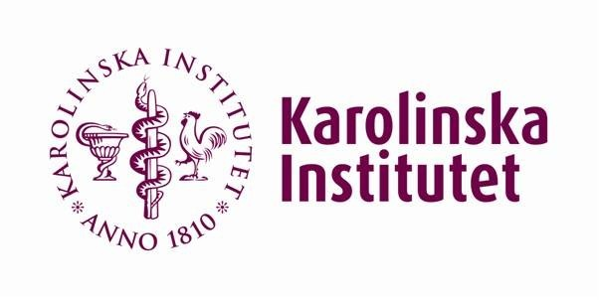
INSURE (INtubate SUrfactant and Extubate) protocol

Slide 41
CPAP in conjunction with surfactant
may decrease the need and duration of mechanical ventilation versus CPAP alone
■
■
reduce the incidence of BPD.
This was best illustrated in a clinical trial of 279 preterm infants (gestational age between 27 and 31 weeks) who required supplemental oxygen within the first hour of life.
Infants were randomly assigned to a combination of initial intubation, surfactant therapy, extubation, and nasal CPAP
or nasal CPAP alone.
The group that was treated with a combination of surfactant/CPAP compared to controls treated with CPAP alone was less likely to need mechanical ventilation (26 versus 39 percent), develop air-leak syndrome (2 versus 9 percent) or BPD (49 versus 59 percent), or require subsequent surfactant therapy (12 versus 26 percent).
Very early surfactant without mandatory ventilation in premature infants treated with early continuous positive airway pressure: a randomized, controlled trial. Rojas MA; Lozano JM; Rojas MX; Laughon M; Bose CL; Rondon MA; Charry L; Bastidas JA; Perez LA; Rojas C; Ovalle O; Celis LA; Garcia-Harker J; Jaramillo ML Pediatrics. 2009 Jan;123(1):137-42.

Slide 42
Early surfactant administration with brief ventilation vs. selective surfactant and continued mechanical ventilation for preterm infants with or at risk for respiratory distress syndrome
Cochrane 2007
Stevens TP, Harrington EW, Blennow M, Soll RF
■
This update includes complete data from three studies published in 2004 or after [Dani 2004, Texas Research
Group, and Reininger 2005 (previously included as D'Angio 2003)] as well as methodological details and outcome
data of the NICHD 2002 trial that was obtained from the investigators [NICHD 2002 (formerly Habermann 2002)].
Six randomized controlled trials of early surfactant administration
■
with rapid extubation vs. selective surfactant and continued mechanical ventilation have been completed.
■
Review of these six trials suggests that early surfactant replacement therapy with extubation to NCPAP compared with later, selective surfactant replacement and continued mechanical ventilation with extubation from low ventilator support is associated with
less need mechanical ventilation
lower incidence of BPD
fewer air leak syndromes.
In a subgroup comparison examining treatment threshold, a lower treatment threshold (FIO2 <= 0.45) confers greater advantage in reducing the incidences of airleak syndromes and BPD; moreover a higher treatment threshold (FIO2 at study > 0.45) had an increased incidence of PDA. These data suggest that treatment with surfactant by transient intubation using a low treatment threshold (FIO2 < 0.45) is preferable to later selective surfactant therapy by transient intubation using a higher threshold for study entry (FIO2 > 0.45) or at the time of respiratory failure and initiation of mechanical ventilation.

Slide 43
What about indications other than
RDS?
■
Secondary surfactant deficiency or dysfunction occurs in other
newborn respiratory disorders, including meconium aspiration
syndrome, pneumonia and pulmonary hemorrhage. A variety of substances, including albumin, meconium and blood inhibit surfactant function.
Two RCTs in babies with severe meconium aspiration syndrome have shown the benefits of surfactant replacement therapy.
Findlay RD, Taeusch HW, Walther FJ. Surfactant replacement therapy for meconium aspiration syndromes. Pediatrics 1996;97:48-52.
Lotze A, Mitchell BR, Bulas DI, Zola EM, Shalwitz RA, Gunkel JH. Multicenter study of surfactant (Beractant) use in the treatment of term infants with severe respiratory failure. J Pediatr 1998;132:40-7.
One studied infants requiring 100% oxygen with an oxygenation index greater than 15, and the other studied infants requiring more than 50% oxygen with an arterial/alveolar O2 tension ratio of less than 0.22. A systematic review reported no differences in mortality or pneumothorax but it showed a decrease in the requirement for extracorporeal oxygenation(evidence level 1a).
■
■

Slide 44
The use of surfactant replacement therapy in neonatal pneumonia has not been adequately studied. A subgroup analysis of near-term
■
babies with respiratory failure from the prospective RCT of Lotze et al, showed that those who had sepsis and were treated with surfactants had a 40% decrease in the need for extracorporeal membrane oxygenation. Other case series of neonatal bacterial
pneumonia appear to show surfactant therapy to be beneficial (evidence level 4).
In controlled trials, exogenous surfactant therapy increases the incidence of pulmonary hemorrhage (30). However, because haemoglobin and other blood components such as fibrinogen have been shown to have serious adverse effects on surfactant function (31), surfactant replacement therapy has also been used to treat pulmonary hemorrhage. There are no RCTs examining the use of surfactant replacement therapy in this condition. Pulmonary hemorrhage is often very acute and unpredictable, and leads to rapid deterioration, which would make a formal RCT difficult.
■

Slide 45
However, the incidence of pulmonary hemorrhage in the most
■
immature infants is as high as 28%, suggesting that there may be
opportunity for a focussed trial in the future. One retrospective cohort study showed a substantial acute improvement in oxygenation in babies with pulmonary hemorrhage who had significant clinical compromise when they were given surfactant replacement therapy (evidence level 4).
Intubated newborn infants with pulmonary hemorrhage which leads to clinical deterioration should receive exogenous surfactant therapy as one aspect of clinical care.
Finally, for lung hypoplasia and congenital diaphragmatic hernia, only small case series have been reported and no conclusions can be made.
■
■

Slide 46
What are the risks of exogenous surfactant
therapy?
■
The short-term risks of surfactant replacement therapy include
bradycardia and hypoxemia during instillation, as well as blockage of the endotracheal tube.
■
There may also be an increase in pulmonary hemorrhage following surfactant treatment; however, mortality ascribed to pulmonary hemorrhage is not increased and overall mortality is lower after surfactant therapy. The RR for pulmonary hemorrhage following surfactant treatment has been reported at approximately 1.47 (95% CI 1.05 to 2.07) in trials but, unfortunately, many of the RCTs on surfactant replacement have not reported this outcome, nor have the data from autopsy studies clearly defined the magnitude of this risk (evidence level 1a). No other adverse clinical outcome has been shown to be increased by surfactant therapy.
– Pappin A, Shenker N, Hack M, Redline RW. Extensive intraalveolar pulmonary hemorrhage in infants dying after surfactant therapy. J Pediatr 1994;124:621-6.
There is often a very rapid improvement in gas exchange in surfactant-treated infants who are surfactant deficient. This is accompanied by dramatic improvements in static pulmonary compliance. In contrast, when dynamic compliance is measured, there is little acute change detected. This discrepancy is explained by the large increase in functional residual capacity due to the recruitment of lung volume (evidence level 1b).
■

Slide 47
Therefore, the pressure volume loops of the lung are normalized,
■
but unless administered pressures are reduced, overdistension can occur. Hyperventilation with very low PCO2 can also sometimes accidentally occur. Thus, weaning of administered airway pressures and ventilator settings should be expected within a few minutes of
the administration of natural surfactants, and the caregivers must be aware of the nature and speed of these changes.
Natural surfactants contain proteins (surfactant protein-A, surfactant protein-B) from bovine or porcine sources and questions have been raised about the immunological effects. To date, there is no evidence that there are immunological changes of clinical concern.
Approved surfactants are produced in accordance with regulated standards of microbiological safety. However, given the uncertainty about the methods of transmission of emerging pathogens such as prions, no comment can be made at the present time about the potential transmission of such agents.
■
■

Slide 48


Slide 49
What are the criteria for, and
timing of, retreatment?
■
There are extremely limited data comparing the different criteria for retreatment (they were decided arbitrarily in the two trials). Kattwinkel et al
compared the relative efficacy of administering second and subsequent doses of a natural surfactant at low (FiO2 greater than 0.30, still requiring
intubation) and high (FiO2 greater than 0.40, mean airway pressure greater than 7 cm H2O) thresholds after a minimum of 6 h. They noted no benefits from retreating at the lower threshold, except in those babies with complicated RDS (evidence of perinatal compromise or sepsis) who had a lower mortality with low threshold retreatment (evidence level 1b).
Retreatment strategies may be dependent on which preparation is used, as some are more prone to protein inactivation. The timing of retreatment has been fairly arbitrarily determined in most of the surfactant trials, but comparisons of the timing of retreatment have been limited and there have been no comparisons of the timing of retreatment between surfactant preparations.
Figueras-Aloy et al randomly compared retreatment at 2 h and 6 h after the initial dose. There appeared to be some short-term advantages to earlier redosing in the smallest infants, but the study was small and no clinically important benefits were shown (evidence level 2).
Recommendation
Retreatment should be considered when there is a persistent or recurrent oxygen requirement of 30% or more and it may be given as early as 2 h after the initial dose or, more commonly, 4 h to 6 h after the initial dose (grade A).
■
■
■
■

Slide 50
How should ventilatory management after
surfactant therapy be approached?
■
Because of the rapid changes in lung mechanics and the
ventilation/perfusion matching that occurs after rescue surfactant therapy, and the prevention of serious lung disease by the prophylactic use of
natural surfactants, many infants can be very rapidly weaned and extubated to nasal continuous positive airway pressure (CPAP) within 1 h of intubation and surfactant administration. To do this, the premedication used for intubation should only cause a brief duration of respiratory depression and staff must be trained and skilled in rapid ventilator weaning. Such weaning is often performed with few or no blood gases, relying instead on the infant’s clinical condition and spontaneous respiratory effort and with consideration of the oxygen requirements as determined from pulse oximetry and sometimes with the use of transcutaneous CO2 measurements.
There is currently no proof that a rapid wean and extubation approach improves long-term outcomes compared with the more traditional weaning approach. In two small randomized trials, such an approach led to a decrease in the need for more than 1 h of mechanical ventilation (evidence level 2b). Definitive recommendations will require further evidence.
Recommendation
Options for ventilatory management that are to be considered after prophylactic surfactant therapy include very rapid weaning and extubation to CPAP within 1 h (grade B).
■
■
■

Slide 51
SUMMARY AND
RECOMMENDATION
Treatment and complications of respiratory distress syndrome in preterm infants – UptoDate.com
■
The administration of antenatal corticosteroid, and prophylactic or
early surfactant therapy to high risk preterm infants reduces the
incidence and severity of RDS.
ACS should be given to any pregnant woman at 24 to 34 weeks of gestation with intact membranes at high risk for preterm delivery ( Grade 1A)
Infants born at or before 30 weeks gestation be intubated and receive either prophylactic or early doses of natural surfactant preparation as soon as they are stable (Grade 1A).
Although the relative efficacy of prophylactic or early doses of natural surfactant preparations is unclear, we suggest that infants receive prophylactic therapy in the delivery room (Grade 2B).
After administration of surfactant and if the infant is active and exhibits spontaneous respiratory effort, we recommend extubation and stabilization on CPAP rather than continued intubation and mechanical ventilation (Grade 1B).
NOT administering prophylactic surfactant therapy for infants greater than 30 weeks gestation (Grade 1B).
■
■
■
■
■

Slide 52
Recommendations for
neonatal surfactant therapy
Fetus and Newborn Committee, Canadian Paediatric Society (CPS) Paediatr Child Health 2005;10(2):109-16 Reference No. FN05-01

Slide 53
What are the indications and benefits of surfactant
replacement therapy?
■
Surfactant replacement therapy, either as a rescue treatment or a
prophylactic natural surfactant therapy, reduces mortality (evidence level 1a) and several aspects of morbidity in babies with RDS .
These morbidities include deficits in oxygenation, the incidence of pulmonary air leaks (pneumothorax and pulmonary interstitial emphysema) and the duration of ventilatory support (evidence level 1a).
Surfactant replacement increases the likelihood of surviving without bronchopulmonary dysplasia (BPD, also known as chronic lung disease of the preterm) largely by improving survival rather than the incidence of BPD.
Babies treated with surfactants have shorter hospital stays and lower costs of intensive care treatment compared with randomized control infants receiving no surfactants. The increase in survival is achieved with no increase in adverse neurodevelopmental outcome (evidence level 1a).
■
■
■
■
■
Recommendation
Intubated infants with RDS should receive exogenous surfactant therapy (grade A).

Slide 54
Recommendations
■
Mothers at risk of delivering babies with less than 34
weeks gestation should be given antenatal steroids according to established guidelines regardless of the availability of postnatal surfactant therapy (grade A).
■
Intubated infants with RDS should receive exogenous surfactant therapy (grade A).
Intubated infants with meconium aspiration syndrome requiring more than 50% oxygen should receive exogenous surfactant therapy (grade A).
Sick newborn infants with pneumonia and an oxygenation index greater than 15 should receive exogenous surfactant therapy (grade C).
Intubated newborn infants with pulmonary hemorrhage
which leads to clinical deterioration should receive exogenous surfactant therapy as one aspect of clinical care (grade C).
Natural surfactants should be used in preference to any of the artificial surfactants available at the time of publication of this statement (grade A).
■
■
■

Slide 55
Infants who are at a significant risk for RDS should receive prophylactic natural surfactant therapy as soon as they are stable within a few minutes after intubation
■
(grade A).
■
Infants with RDS who have persistent or recurrent
oxygen and ventilatory requirements within the first 72 h
of life should have repeated doses of surfactant. Administering more than three doses has not been shown to have a benefit (grade A).
Retreatment should be considered when there is a
persistent or recurrent oxygen requirement of 30% or more, and it may be given as early as 2 h after the initial dose or, more commonly, 4 h to 6 h after the initial dose (grade A).
Options for ventilatory management that are to be considered after prophylactic surfactant therapy include very rapid weaning and extubation to CPAP within 1 h (grade B).
Intubated infants with RDS should receive exogenous
surfactant therapy before transport (grade C).
■

Slide 56
Centres administering surfactant to newborn infants must ensure the continuous on-site availability of personnel competent and licensed to deal with the acute complications of assisted ventilation and surfactant therapy (grade D). Mothers with threatened delivery before 32 weeks gestation should be transferred to a tertiary centre if at all possible (grade B).
Infants who deliver at less than 29 weeks gestation outside of a tertiary centre should be considered for immediate intubation followed by surfactant administration after stabilization, if competent personnel are available (grade A).
Further research into retreatment criteria and the optimal timing of prophylactic therapy is required.

Slide 57
Other units’ protocols…

Slide 58

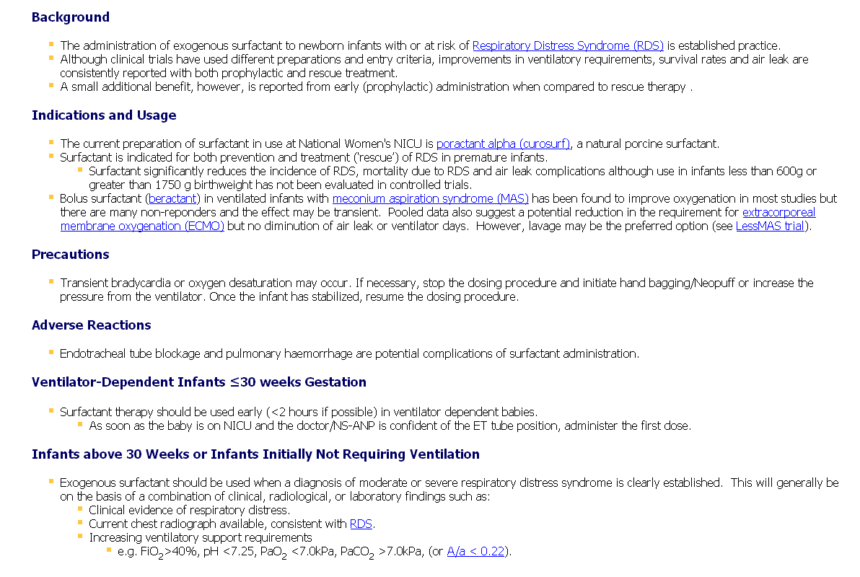

Slide 59
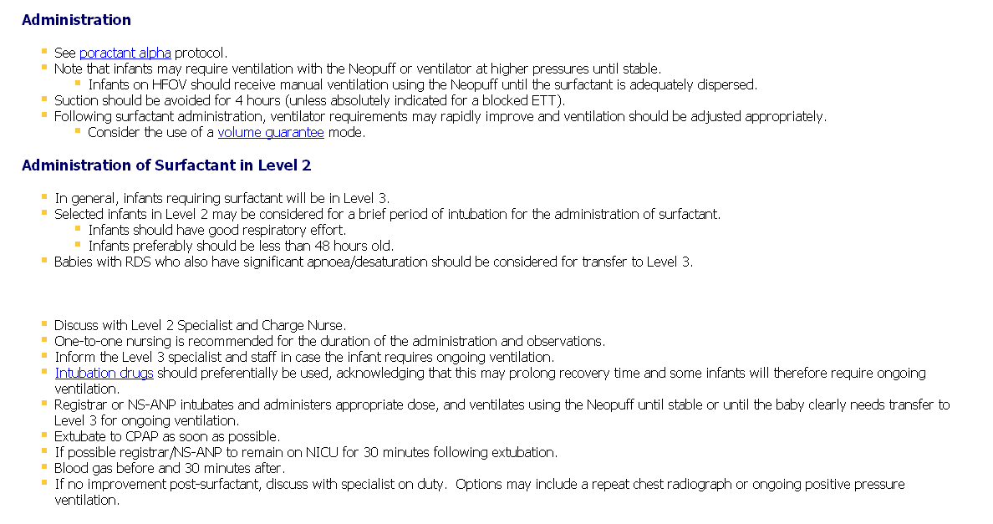

Slide 60
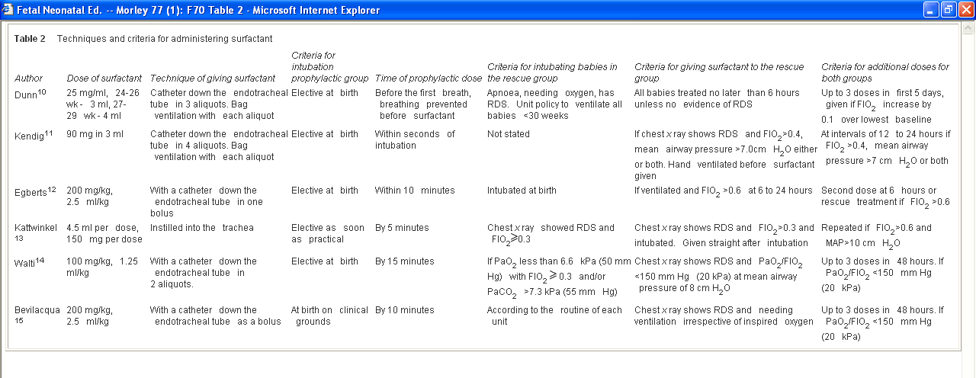

Slide 61

The unexamined life is not worth living
Socrates 499 BC

Slide 62


