Slide 1
MAKING WAVES
MAKING WAVES

Slide 2
MAKING WAVES
Electrodes can be placed anywhere on the surface of the body in order to record the heart's electrical activity.
Waves recorded by a positive electrode on the left arm look very different from those recorded by a positive electrode on the right arm (or right leg, left leg, etc.).
A wave of depolarization moving toward a positive electrode causes a positive deflection on the EKG.

Slide 3
MAKING WAVES
A wave of depolarization moving away from a positive electrode causes a negative deflection.

Slide 4
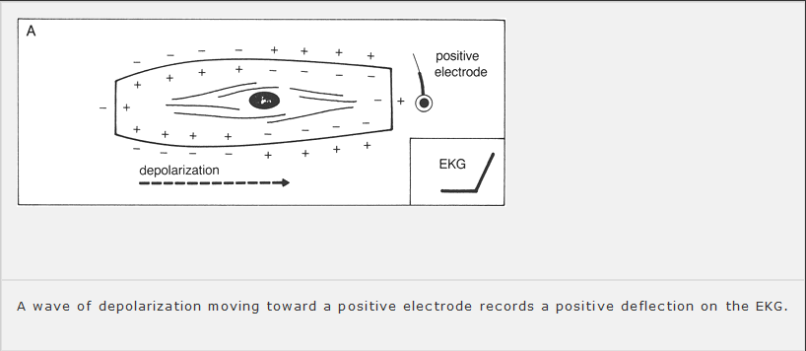
MAKING WAVES

Slide 5
MAKING WAVES
The wave of depolarization is moving right to left.
The electrode is placed so that the wave of depolarization is moving away from it.
The EKG therefore records a negative deflection

Slide 6
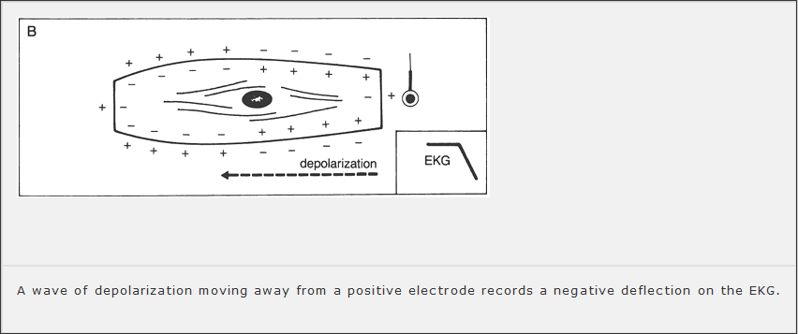
MAKING WAVES

Slide 7
MAKING WAVES
What will the EKG record if the positive electrode is placed in the middle of the cell?
Initially, as the wavefront approaches the electrode, the EKG records a positive deflection.
Then, at the precise moment that the wave reaches the electrode, the positive and negative charges are balanced and essentially cancel each other out.
The EKG recording returns to baseline.

Slide 8
MAKING WAVES
As the wave of depolarization recedes, a negative deflection is inscribed.
The EKG finally returns to baseline once again when the entire muscle is depolarized.

Slide 9
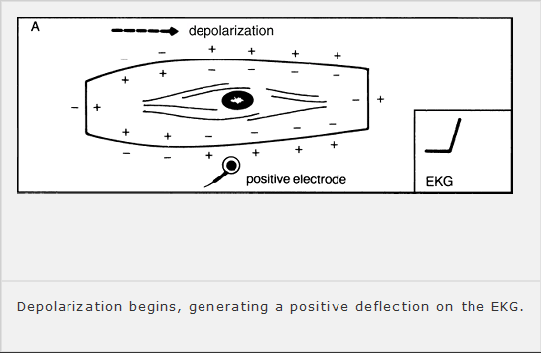
MAKING WAVES

Slide 10
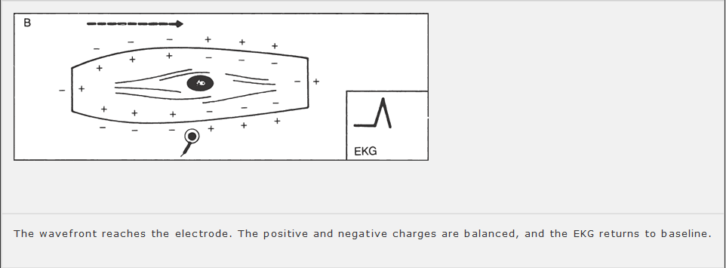
MAKING WAVES

Slide 11
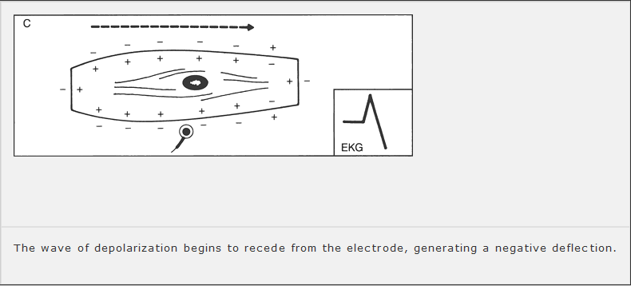
MAKING WAVES

Slide 12
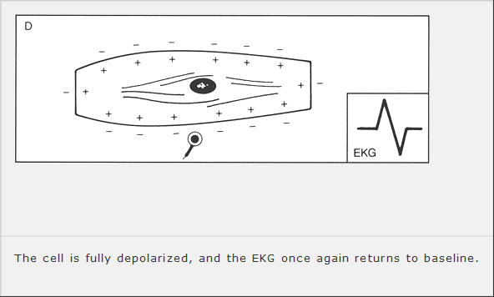
MAKING WAVES

Slide 13
MAKING WAVES
The final inscription of a depolarizing wave moving perpendicularly to a positive electrode is therefore a biphasic wave.
What would the tracing look like if the recording electrode were placed over a section of pacemaker cells?
The tracing would show a downward, negative deflection, since all the current is moving away from the origin where you are recording.

Slide 14
MAKING WAVES
The effects of repolarization on the EKG are similar to those of depolarization, except that the charges are reversed.
A wave of repolarization moving toward a positive electrode inscribes a negative deflection on the EKG.
A wave of repolarization moving away from a positive electrode produces a positive deflection on the EKG.

Slide 15
MAKING WAVES
A perpendicular wave produces a biphasic wave.
However, the negative deflection of the biphasic wave now precedes the positive deflection.

Slide 16
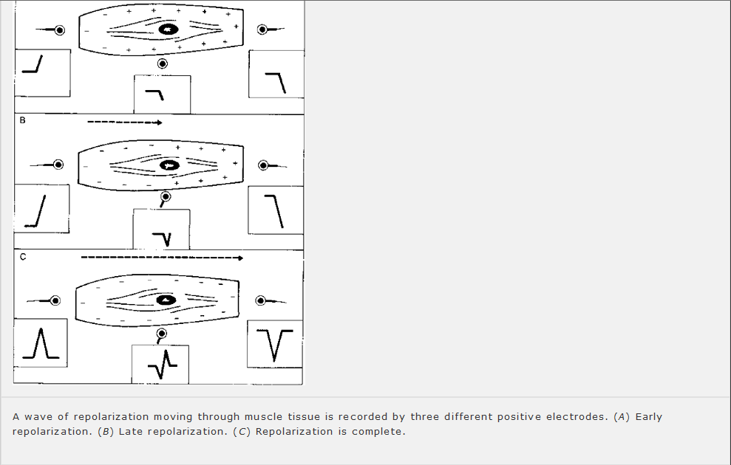
MAKING WAVES

Slide 17
MAKING WAVES
We can easily apply these concepts to the entire heart.
Electrodes placed on the surface of the body will record waves of depolarization and repolarization as they sweep through the heart.
If a wave of depolarization passing through the heart is moving toward a surface electrode, that electrode will record a positive deflection.

Slide 18
MAKING WAVES
If the wave of depolarization is moving away from the electrode, the electrode will record a negative deflection (electrode B).
If the wave of depolarization is moving perpendicularly to the electrode, the electrode will record a biphasic wave (electrode C).
The effects of repolarization are precisely the opposite of those of depolarization.

Slide 19
MAKING WAVES
If the wave of depolarization is moving away from the electrode, the electrode will record a negative deflection (electrode B).
If the wave of depolarization is moving perpendicularly to the electrode, the electrode will record a biphasic wave (electrode C).
The effects of repolarization are precisely the opposite of those of depolarization.

Slide 20
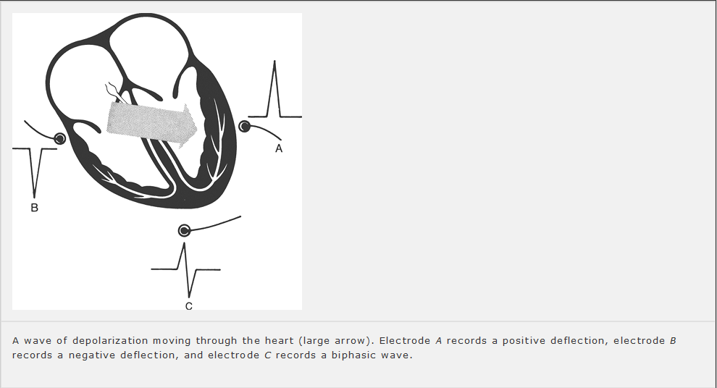
MAKING WAVES

Slide 21
THE END
THANK YOU

